Slide 1

Introduction to TBIL
TBIL Community

Slide 2

This material is based upon work supported by the National Science Foundation under Award #2011807. Any opinions, findings and conclusions or recommendations expressed in this material are those of the author(s) and do not necessarily reflect the views of the National Science Foundation.

Slide 3
Learning Objectives
Be able to describe the basic structure of a TBIL class and 4-S activities
Be able to articulate how TBIL supports the four pillars of IBL
Be able to compare and contrast the three types of TBIL activities

Slide 4
Motivation: Implementing IBL in Lower Division Courses
Inquiry-Based Learning’s effectiveness is well supported by large research studies
IBL is most often used in upper division courses
IBL is most often used in smaller courses
Challenge: How can we bring the benefits of IBL into our larger, lower division service courses?

Slide 5
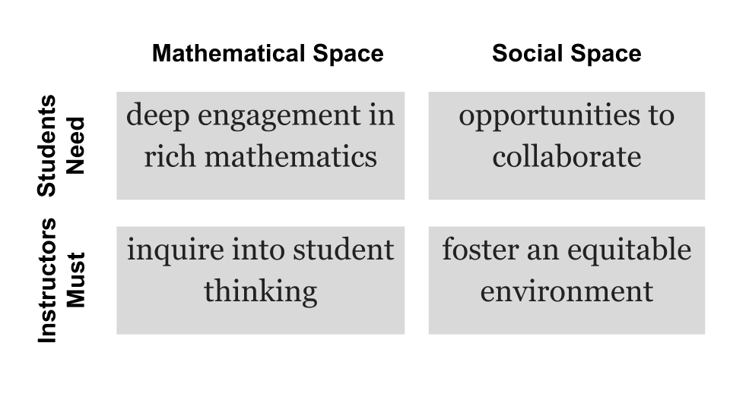
The 4 pillars of Inquiry-Based Learning
Four pillars by Laursen & Rasmussen (2019), diagram by Nina White

Slide 6
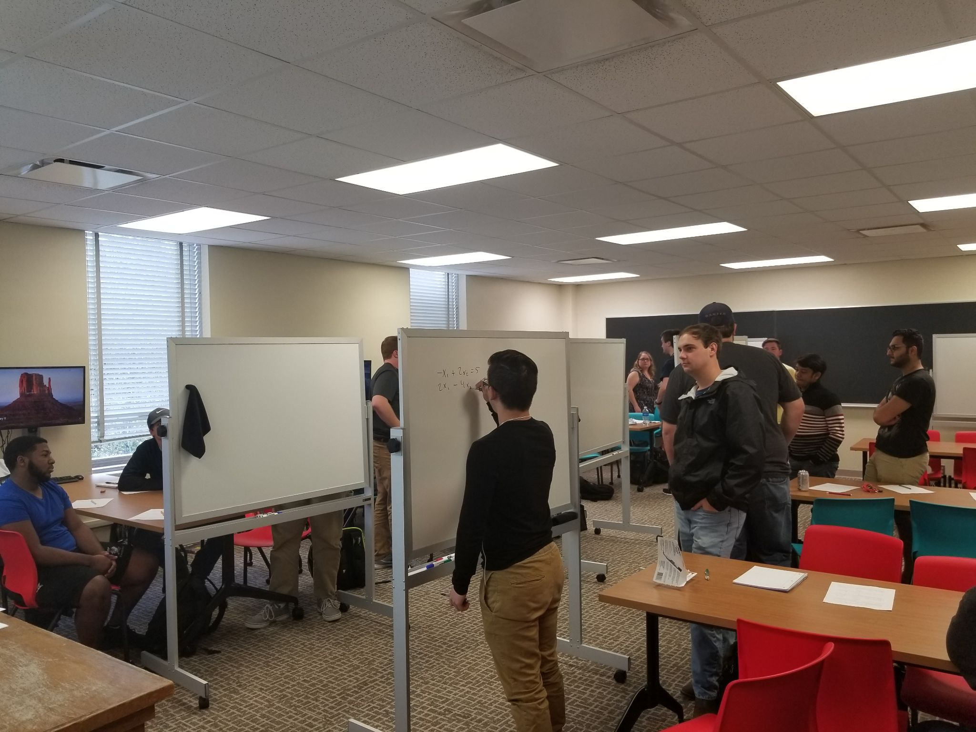
Team-Based Learning
Students work in permanent, heterogenous teams
Students complete pre-class work to free up class time for engaging activities
Students work in teams during class on significant problems to deeply learn
Notes:
Specific choice also forces students to collaborate

Slide 7
Team-Based Inquiry Learning
Team-
Based
Learning
Inquiry-
Based
Learning
TBIL

Slide 8
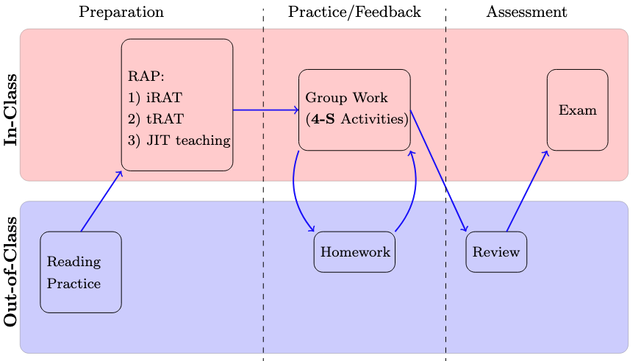
Structure of a TBIL Module

Slide 9
Readiness Assurance Process
Every module begins with a readiness assurance process
Students prepare outside of class
Students take a readiness check individually
Immediately afterwards, teams collaborate on the same readiness check
Resolve any outstanding misconceptions with Just-In-Time teaching
Preparation
iRAT
tRAT
JIT Teaching

Slide 10
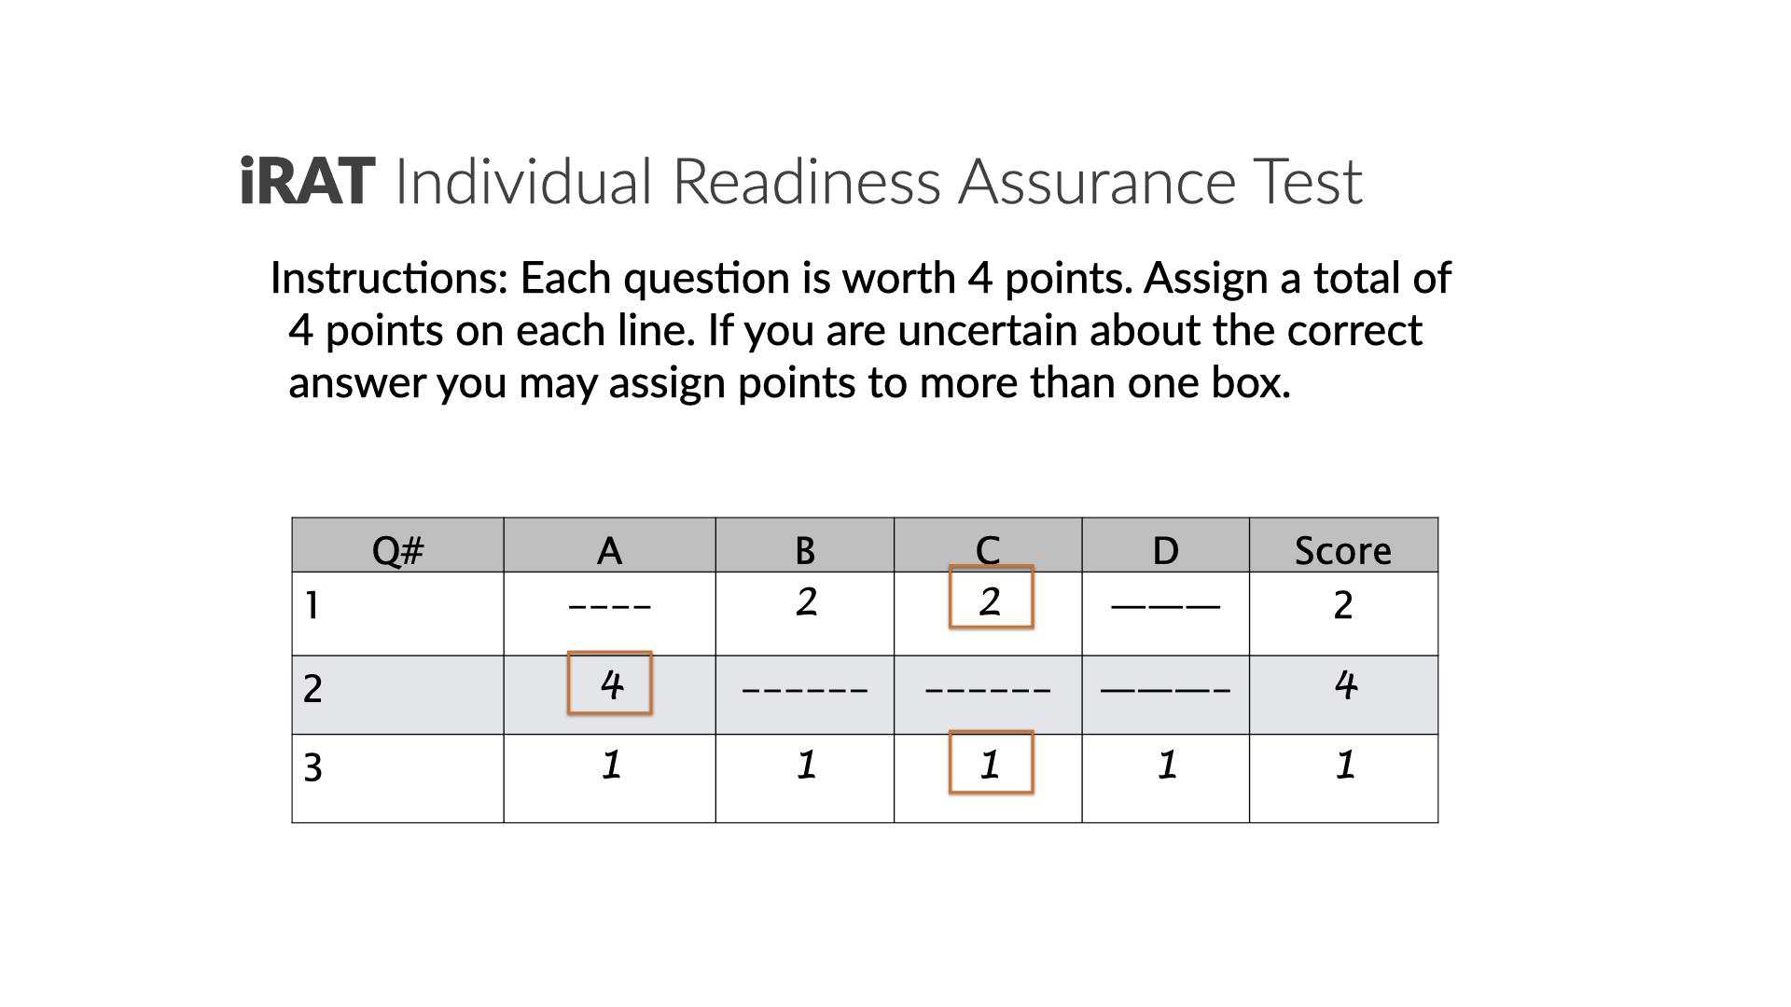

Slide 11
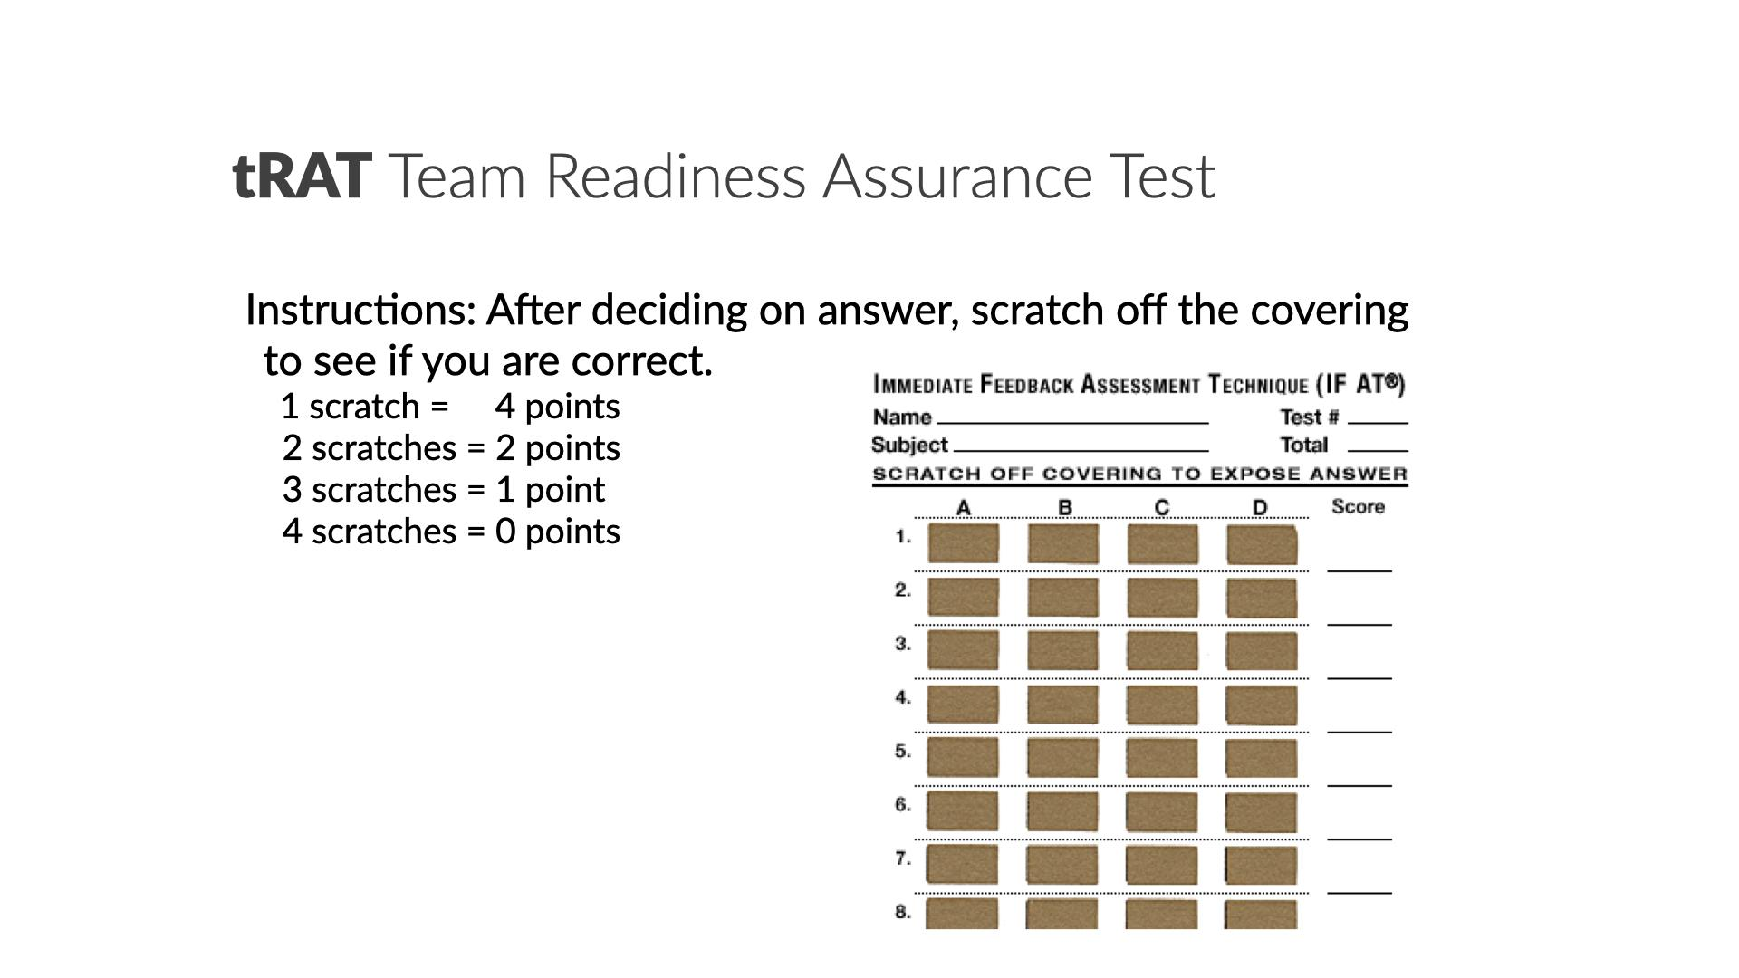

Slide 12
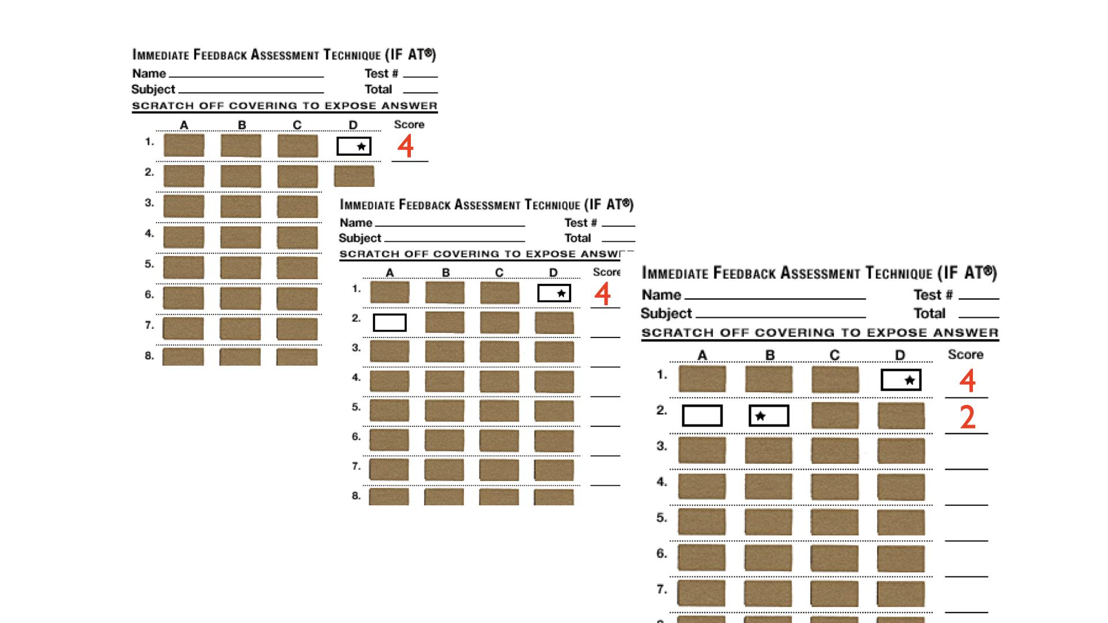

Slide 13
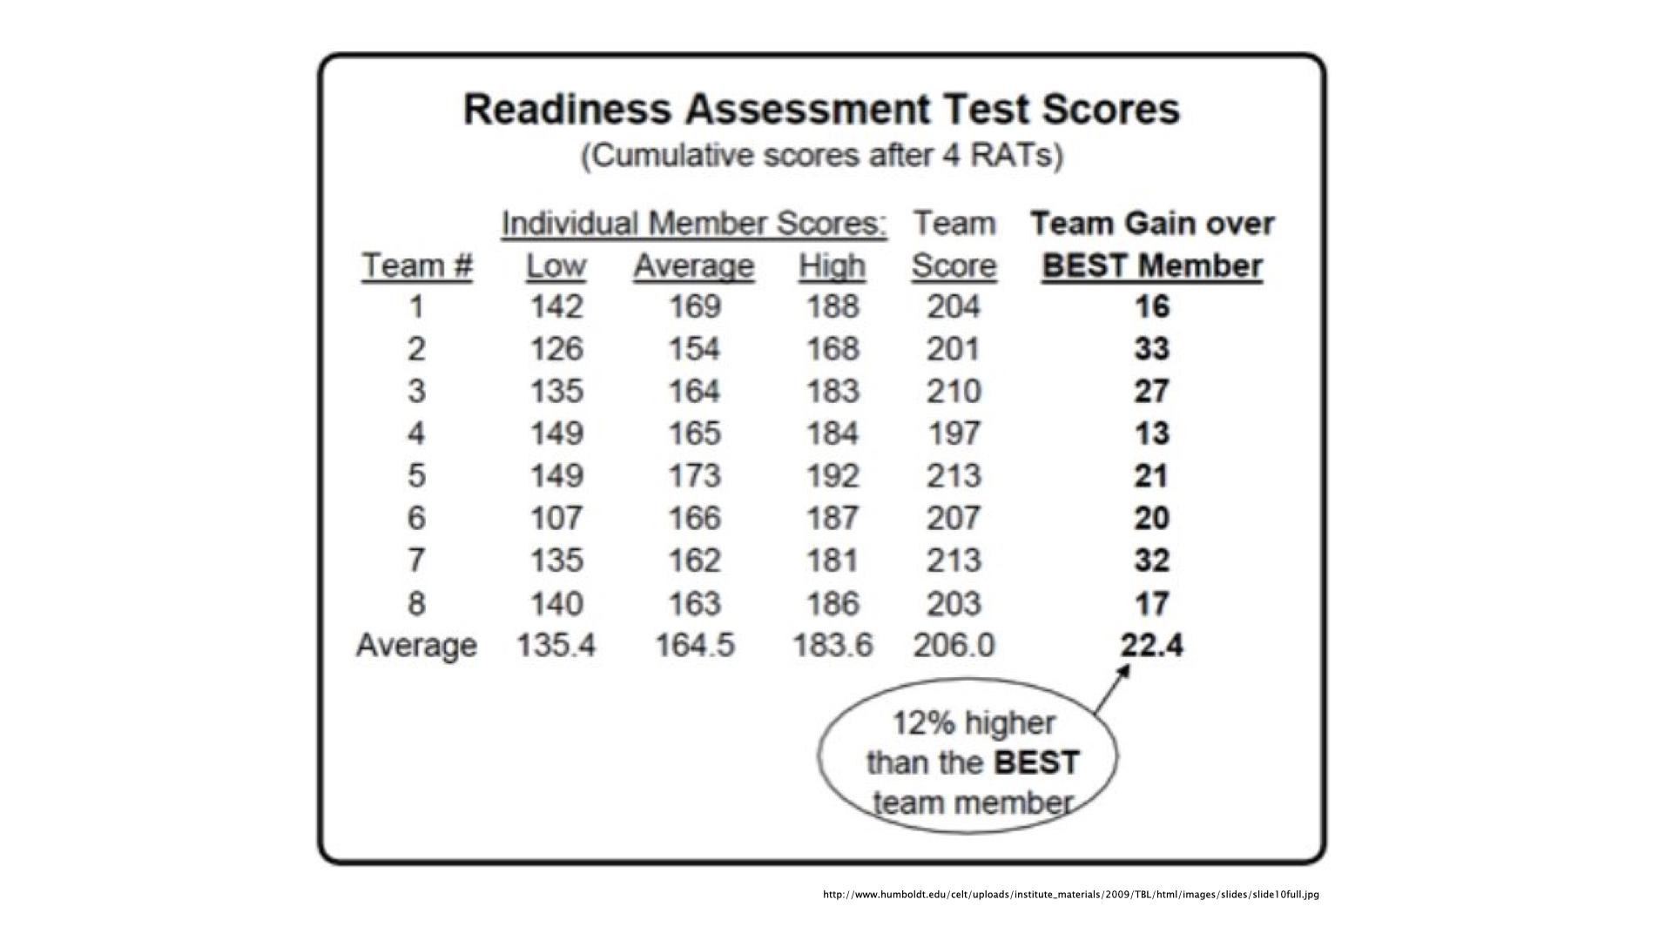

Slide 14
Won’t students just vote on the answer?
In our study, tRAT scores were 9.7% higher than a voting strategy would produce
This is matched by our classroom observations

Slide 15
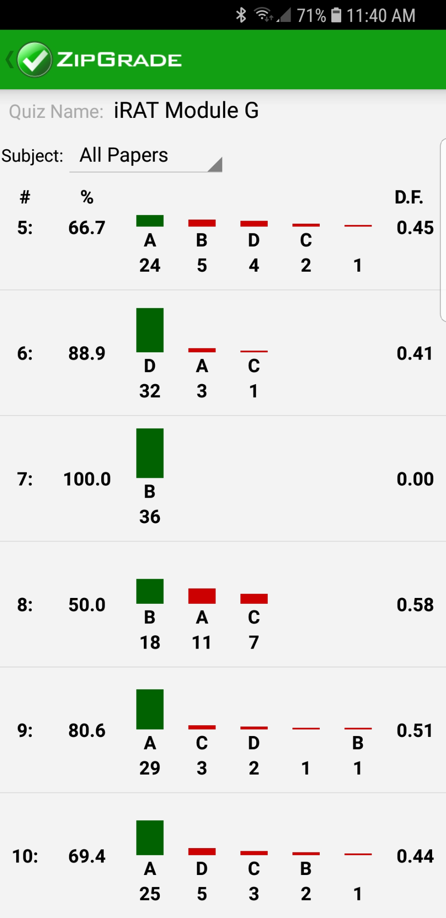
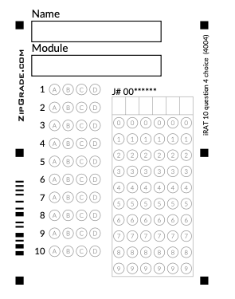
Just-in-Time Teaching

Slide 16
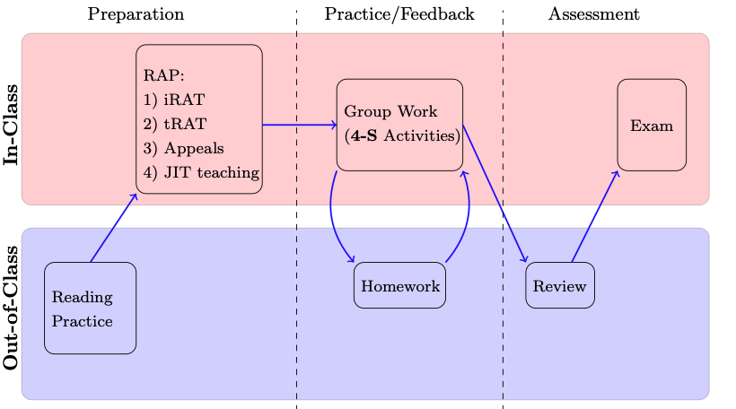
Structure of a TBIL Module

Slide 17
4-S Activities
The bulk of class time is spent with students working in teams on 4-S Activities
Teams work on the Same task
The task is a Significant task
Teams commit to a Specific choice
Teams Simultaneously report their choice

Slide 18
Facilitating 4-S Activities
The bulk of class time is spent with students working in teams on 4-S Activities
Teams discuss/solve the task within their team first
Instructor circulates, eavesdropping and facilitating intra-team discussions
Teams simultaneously report their response to the class
The facilitator asks teams to explain their reasoning

Slide 19
Activity 1: Which aspect of the 4-S structure is most helpful in math classes?
Teams work on Significant, inquiry-driven tasks to develop deep conceptual understanding
Teams work on the Same task, allowing instructors to compare different teams’ reasoning and approaches
Teams must commit to a Specific choice or answer, helping them focus and providing a common point of comparison between teams’ reasoning
Teams Simultaneously report their answer, ensuring each team commits to their own choice rather than simply agreeing with other teams.

Slide 20
Activity 2: An instructor new to TBL decides to save time by omitting the tRAT portion of TBL. How will this action most likely impact learning?
Decreased individual preparation, since less time is spent assessing content mastery.
Decreased individual preparation, since there is less accountability to teammates.
Decreased content mastery, as students are less ready to engage with the 4-S activities.
Improved higher learning skills, since there is more time available for the 4-S activities.
Improved team cohesiveness, since there is less opportunity for team dissension.

Slide 21
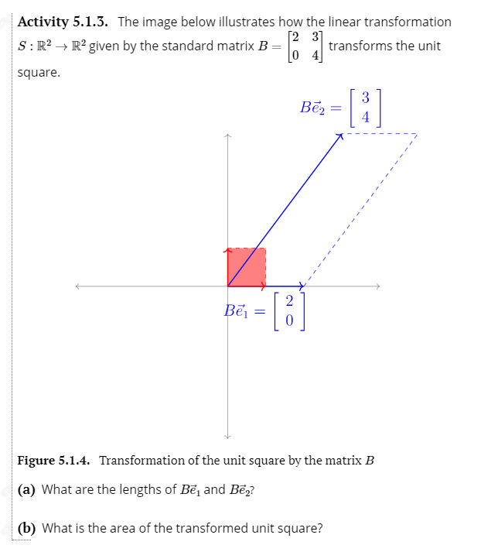
Readiness Assurance Process
Often students need to remind themselves of pre-requisite knowledge from previous courses
When building on topics from earlier in the course, explicitly call this out

Slide 22
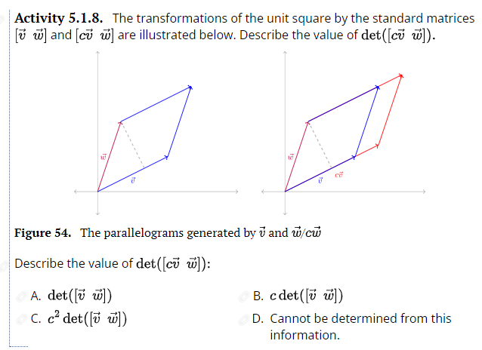
What prerequisite knowledge do students need to be able to answer this question?

Slide 23
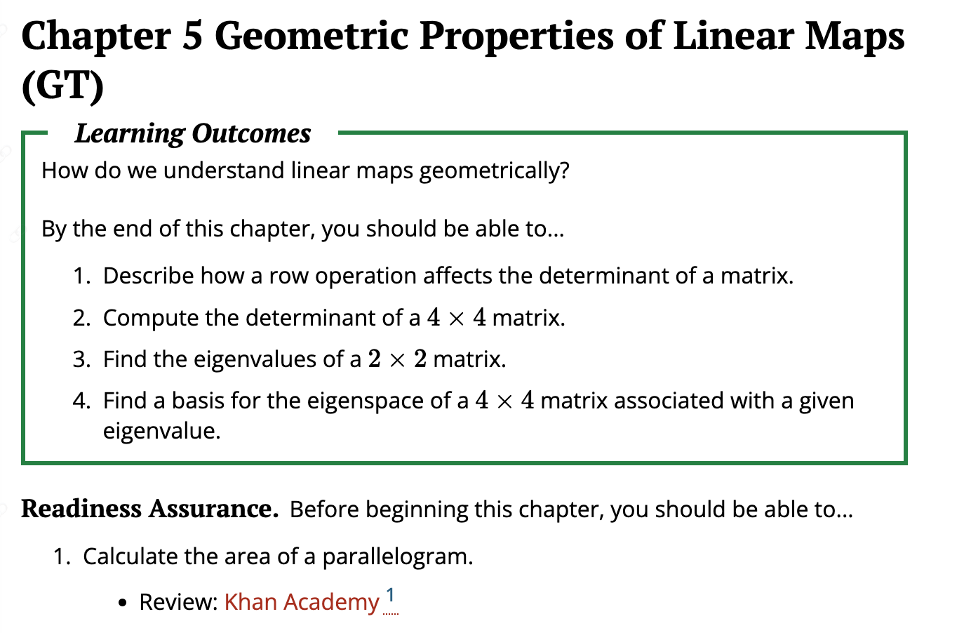
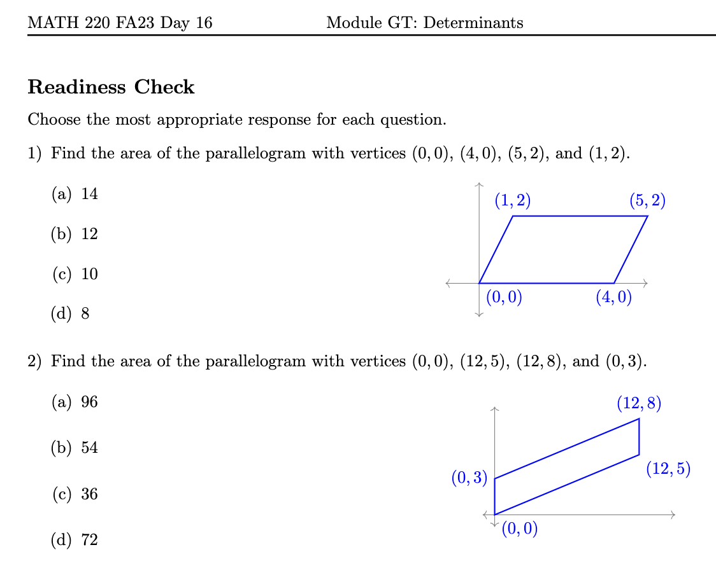
References…
…Test
Notes:
Once we have addressed just-in-time needed prereqs, we can move to the new content and fun activities! Let’s look at these a bit more

Slide 24
Types of TBIL 4-S Activities
Scaffolded Exploration and Discovery
Fluency Builders
Flexible Extension

Slide 25

Scaffolded Exploration & Discovery
Explore a new idea
Motivate a definition or a technique
Carefully scaffolded

Slide 26
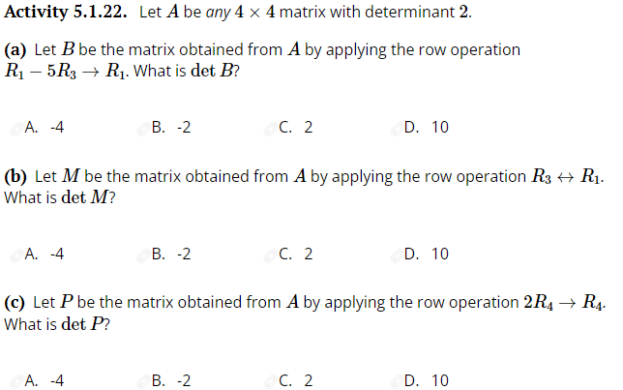
Fluency Builders
Build procedural fluency
Scaffolding (partly or completely) removed

Slide 27
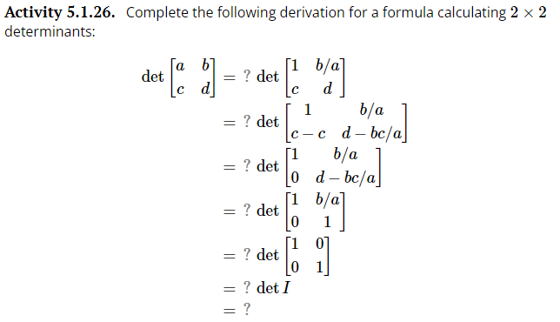
Flexible Extension
Apply existing knowledge to new context
Pushes student thinking forwards

Slide 28
Activity 3: Which type of TBIL class activity do you think is most essential for student learning?
Scaffolded Exploration
Fluency Builder
Flexible Extension
Notes:
Can be omitted for time.

Slide 29
Activity 4: Which aspect of TBIL that BEST addresses issues with group work.
Individuals are held accountable through the iRATs and individual grades.
Students rate their teammates leading to a Team Contribution component of the final course grade.
4-S activities are conducted as ungraded in-class activities with no group work assigned outside of class.
The 4-S approach to application activities eliminates a “divide and conquer” approach.
Notes:
Can be omitted for time.

Slide 30
Activity 5: Which strategy is best to ensure all students have the opportunity to share their thinking in whole class discussions?
Assign a student from each group to be the group reporter (rotating each class)
Tell teams that a member cannot report more than once each class
Share a quiet student’s thinking for them to the whole class
Privately invite quiet students to share particular ideas you overhear them say in their group
Notes:
Can be omitted for time.

Slide 31
In as few words as possible… TBIL features
TBL scaffolding + IBL inquiry
Application activities which foster class discussion
Readiness Assurance Process to ensure students are ready
Scaffolding for progression in cognitive demand

Slide 32
TBIL Resources
TBIL Resource Library: https://tbil.org
Activity books
Exercise banks
TBIL Community Slack

